Slide 1
Proposed New Website WFFC New Member Applicant Induction Management Process
Jim Goedhart - WFFC Website Development Committee Chair
11/30/16

Slide 2
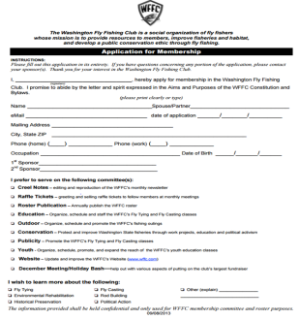
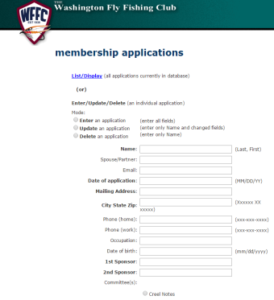
Current New Member Applicant Induction Management Process Overview
A prospective member obtains a hardcopy of the WFFC Application for Membership either from their Sponsor, at a Dinner Meeting from the 1st VP Membership or Ghillie, on downloads a pdf copy off of the about us WFFC.com website.
The applicant fills out the Application for Membership form which is given directly to or given to the 1st VP Membership by their Sponsor or the Ghillie.
The Bylaws require that a prospective member attended three WFFC Events involving Dinner Meetings and/or Outings to begin the induction process. Often the member attends the 3 events to decide if they want to be a member and then fills out the Application for Membership to start the induction process. This also gives the membership a chance to meet the applicant to get to know them and to be sure they are acceptable to become a member as well (this applies mainly when the applicant has no membership sponsor).
Once the 1st VP Membership receives the Application for Membership (and the 3 Events attendance criteria has been meet), it is recorded in to the Website by the 1st VP or is scanned and emailed to the Webmaster to enter it.
WFFC.com
Application enterd

Slide 3
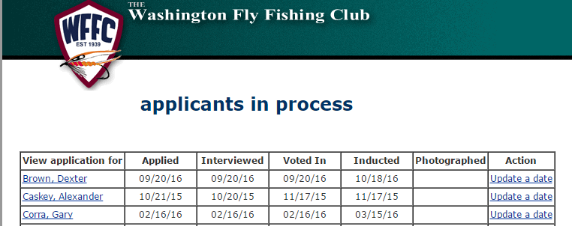
Current New Member Applicant Induction Management Process Overview
The input of the Application for Membership also automatically records their name in the WFFC.com “applicants in process” status tracking report which is accessed and updated by the 1st VP to record the following induction step occurrences:

Slide 4
Current New Member Applicant Induction Management Process Observations
No straight forward way for a prospective applicant to obtain an Application for Membership to fill out: Sponsor, 1st VP Membership, Ghillie or Download a pdf.
Takes one or two individuals to enter the applicant’s Application for Membership information into WFFC.com
The WFFC.com “applicants in process” screen is good that it lists out the names of the applications and provides the ability to record the date that the individual induction steps occurred.
It is missing the ability to record the date that WFFC Name Badge was issued to the new member by the 1st Ghillie.
No ability to track if the newly inducted member paid their dues

Slide 5
Proposed New Member Applicant Induction Tracking Process
New Member applicants fill out Membership Application through the public side of the WFFC.com Website and clicks on the “Submit” which:
Records the application information into the “Prospect” Group for tracking purposes.
Generates a “New Applicant Notice” email which is sent to 1st VP Membership with contact information for the review the applicant's application and invitational follow-up activities.
The 1st VP Membership views the website “Prospects Report” which list the applicants names, their initiation progress status and clicks on the member’s name to view their application information:
Dues Paid Date
Will be added to the
report here shortly.

Slide 6
Proposed New Member Applicant Induction Tracking Process -continued
As a new Member applicant completes each membership induction steps, the responsible Board or Committee member records their activity completion date by:
Clicking on the applicants name listed in the Prospect Report to display the applicants “User” record
Under the “User Membership Fields” in the applicant’s User record, scrolls down to one of the following listed induction activities and enters its completion date and then clicks on the (See following Screen Shot):
Interviewed – Recorded by 1st VP Membership
Voted In – Recorded by 1st VP Membership
Last Dues Paid Year – Recorded by Treasurer
After the New Member’s Dues Check is received from the 1st VP Membership
Inducted – Recorded 1st VP Membership
Photographed – by the club Photographer
Emails the New Member photo to the Webmaster for Roster Posting
Badged – by the 1st or 2nd Ghillie when the New Member received their WFFC Name Badge
Once all of the above application activity dates have been entered, the Webmaster updates the New Member Status from Applicant to Member and reassigns their User Group from “Prospect” to “Active” (which will remove them from the Prospects Report as well).

Slide 7
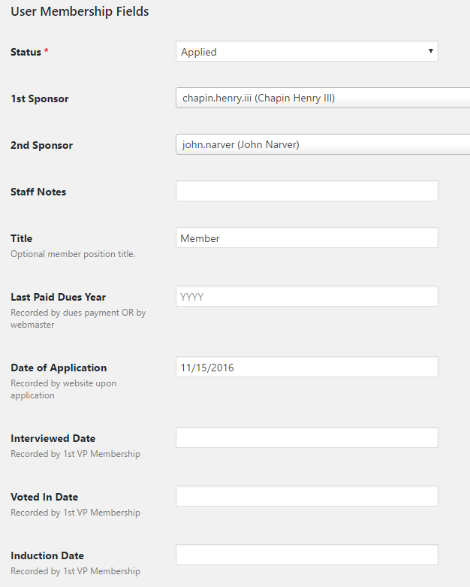
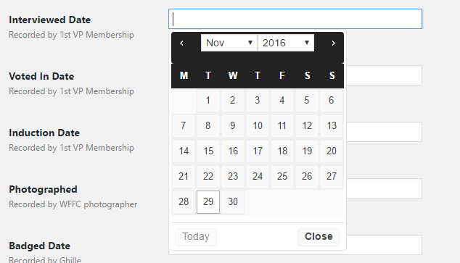
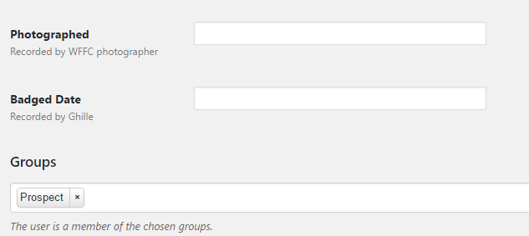
Website User Record – User Membership Fields Screen Shot
Click on the calendar day to record the activity completion date
Access to the applicants User Record from the Prospect Report will to limited to:
1st VP Membership
Treasure
Ghillie
WFFC Photographer

